Slide 1
MATLAB

Slide 2
INTRODUCTION
MATLAB - to analyze and design the systems and products
MATLAB code can be integrated with other languages, enabling you to deploy algorithms and applications within web, enterprise, and production systems.

Slide 3
MATLAB
MATLAB is an abbreviation for "matrix laboratory."
While other programming languages usually work with numbers one at a time
MATLAB® operates on whole matrices and arrays.
Language fundamentals include basic operations, such as creating variables, array indexing, arithmetic, and data types.

Slide 4
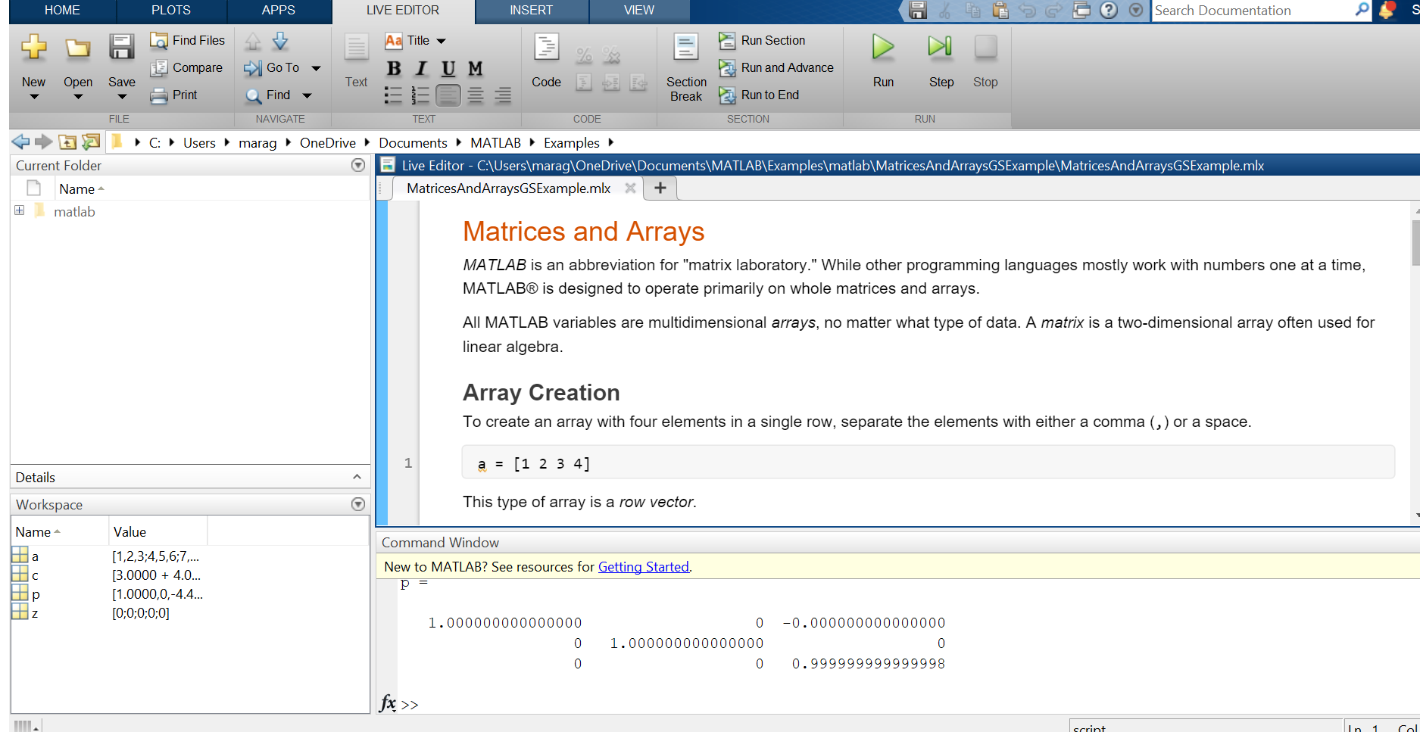

Slide 5
about - ans
Perform a simple calculation in the Command Window without assigning the result to a variable. MATLAB stores the result in the ans variable.

Slide 6
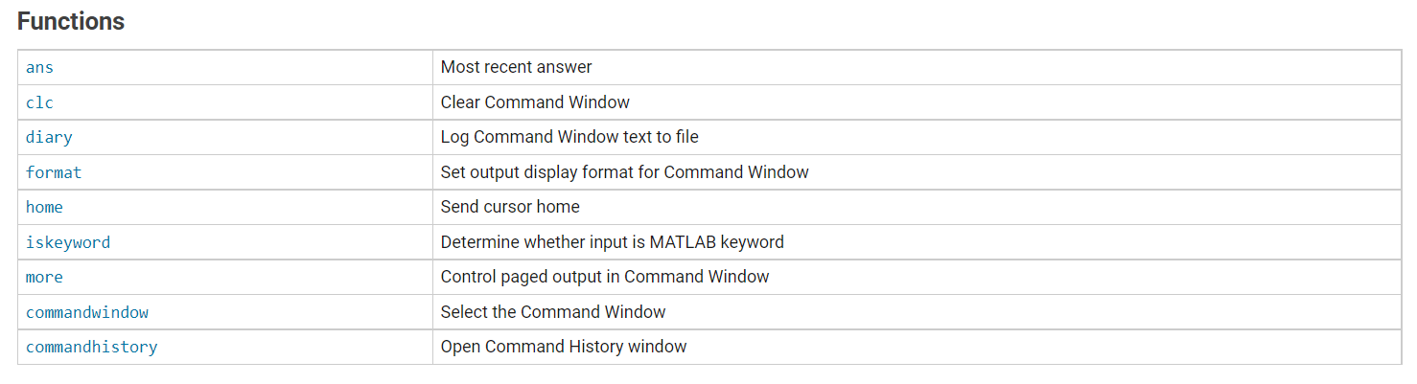
Functions

Slide 7
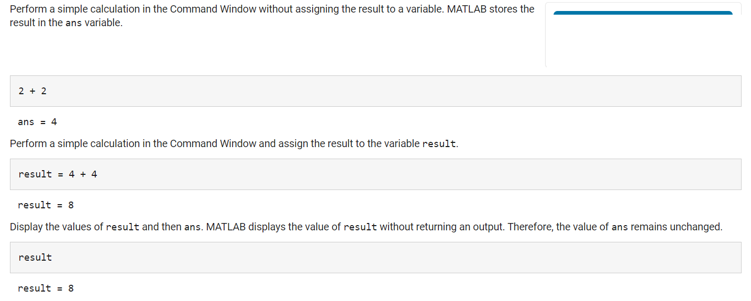
Command window - Simple computation with / without variable

Slide 8
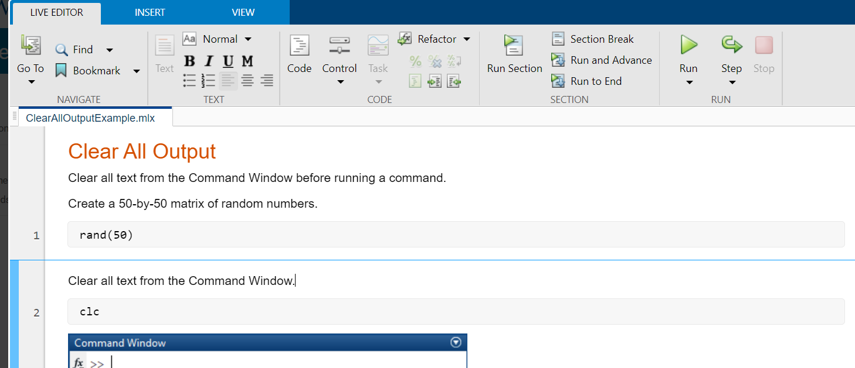
clc

Slide 9
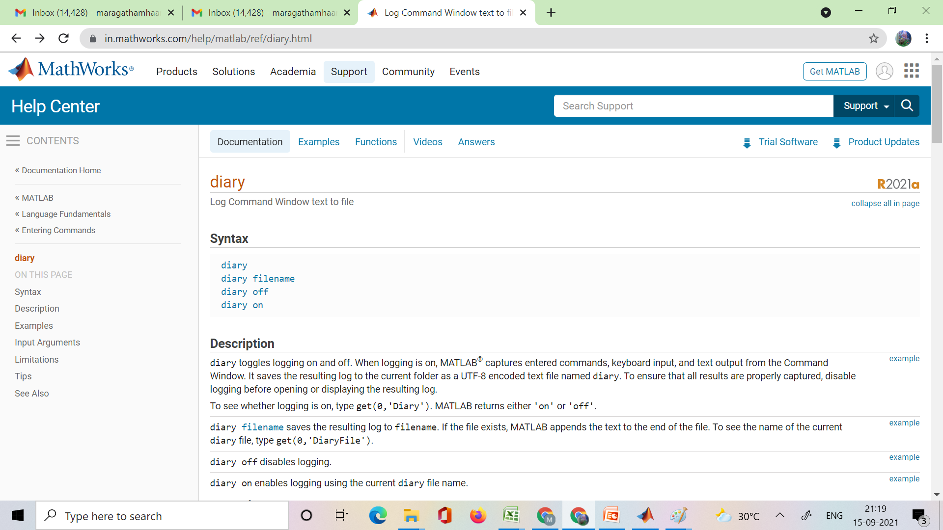
diary

Slide 10
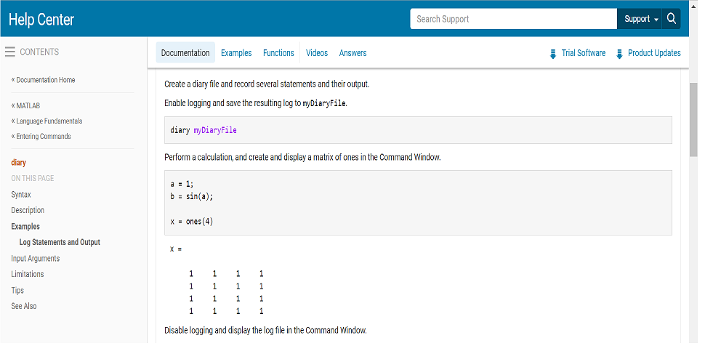

Slide 11
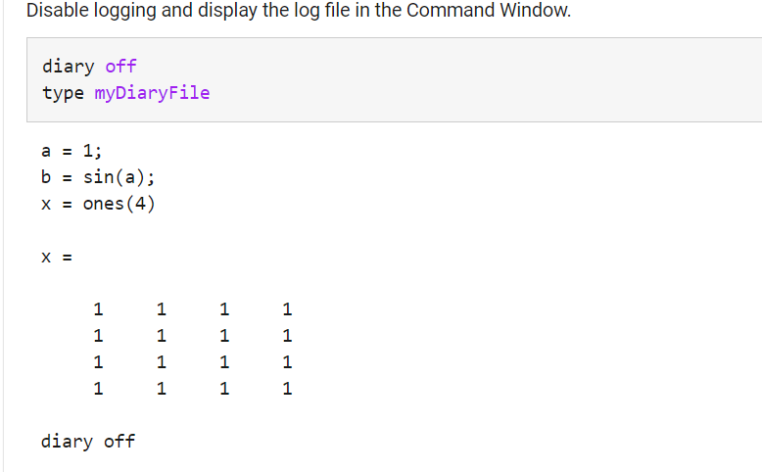

Slide 12
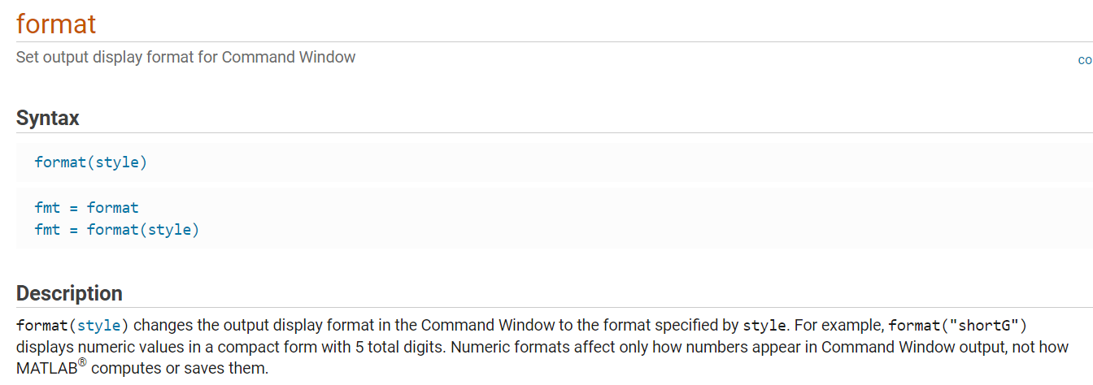
format

Slide 13
format
format(style) changes the output display format in the Command Window to the format specified by style.
For example, format("shortG") displays numeric values in a compact form with 5 total digits.

Slide 14
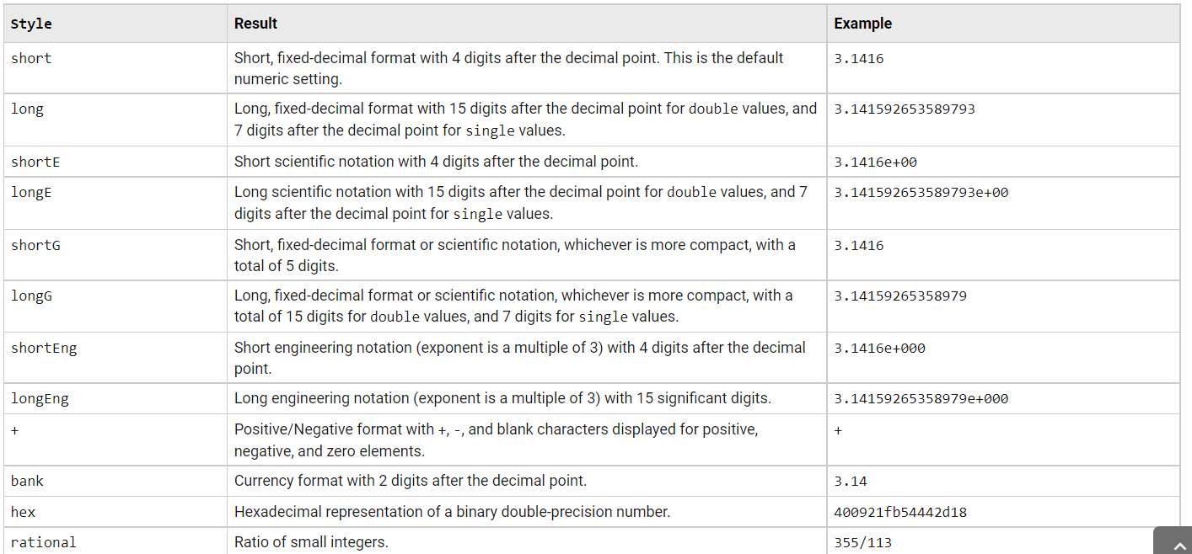
format

Slide 15
Working with arrays
Let us explore…

